Slide 1
Lobbying and advocacy in the US:
The good, the bad, and the ugly
Randy Tucker, Legislative Affairs Manager
Metro Regional Government, Portland, Oregon, USA
Yerevan, Armenia
September, 2013
Notes:
In theory there is no difference between theory and practice. In practice there is.
Politics is the art of looking for trouble, finding it whether it exists or not, diagnosing it incorrectly, and applying the wrong remedy.

Slide 2
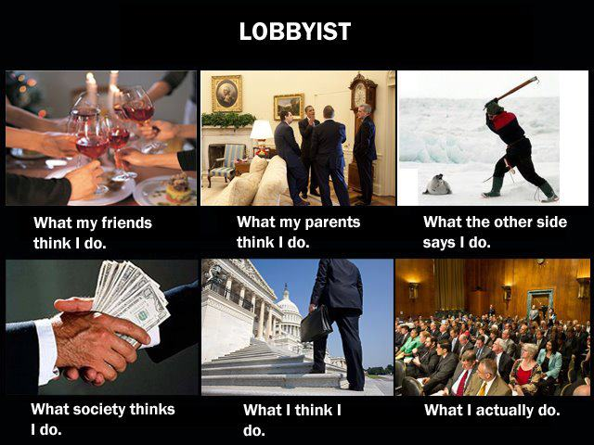

Slide 3
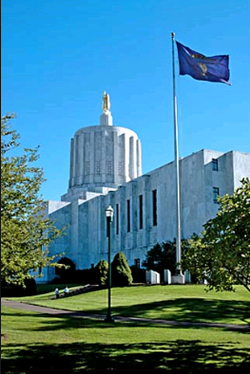

Slide 4
Why do we need lobbyists?

Slide 5
It’s not easy to do the right thing

Slide 6
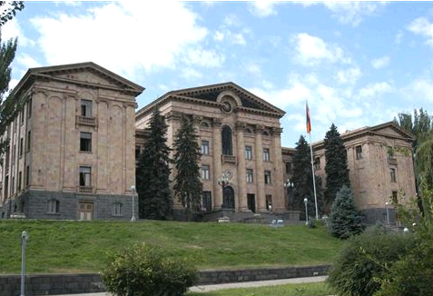
Thank you.
Randy Tucker Legislative Affairs Manager
Metro regional government, Portland, Oregon, USA
randy.tucker@oregonmetro.gov

